Slide 1


Slide 2
Problem ID
PS: GH-06
TITLE :
Open Innovation(Mess Management System)

Slide 3
Problem Statement:-
The old mess system has many drawback as mention below:
Supervisor
Register Maintain
Diet Maintain on Register
Handling Records
Time Consuming
Less Secure
Students
Monthly Diet Check
Complaints

Slide 4
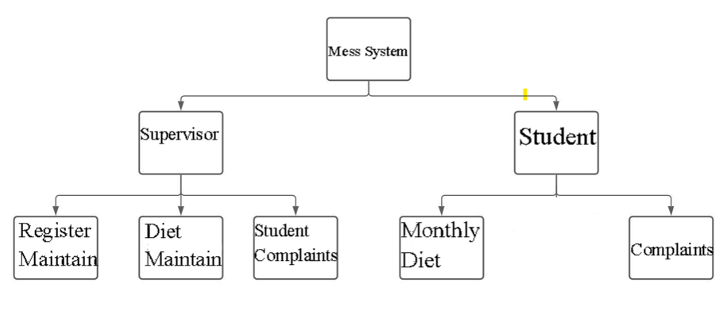
OLD Model

Slide 5
Mess Operations
Problem Solution
To manage the mess,student registration, the system checks inventory , submits order and approves vendor availability.
The operations done by this sub node are:
New Admission
Withdraw Admission
Update Creds
Records of Student order
Student Data
Order New Items for Mess
Change the status of item
Pantry

Slide 6
Mess Student
Mess Student for placing an order and checking Monthly Diet.
The operations performed by this sub node are :
Place Order
Account Details
Register Complaints

Slide 7
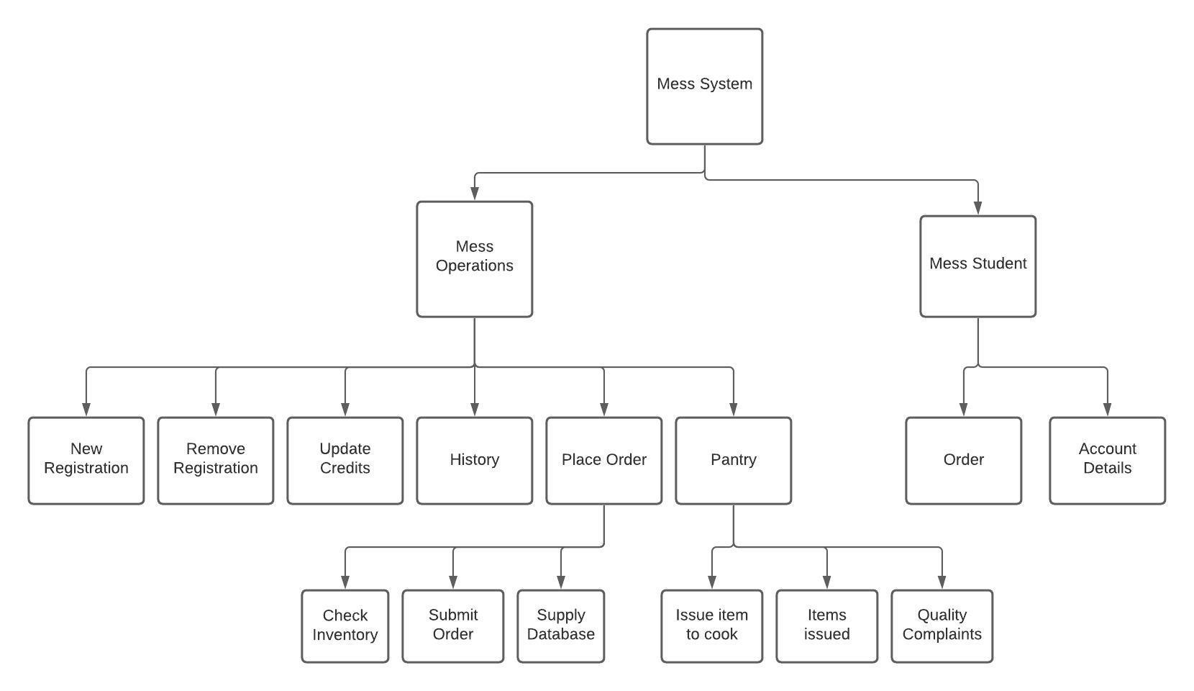
NEW Model Cartesian Decomposition

Slide 8
New Admission is used to register to new student to the mess and further credits is added to the account according to the money provided.
Withdraw Admission is used to remove student from the system.
Update Creds is further used for adding credits to the account for which items can be bought at students counter.
Records is used to check history of order placed by the student in the system.
Student Data has records of all the students of the Hostel.
Order New Item for Mess is used for order new item like vegetables, utensils.
Change the Status of the Items is used to update the item available in the Mess.
Pantry

Slide 9
Features
Also available in Website and App Form.
Digital System.
Time Saving System.
User Friendly System.

Slide 10
Future Upgrades :
Online Mess Diet Fee Payment.
Online Diet Off.
Proper Authentication.
Keep Track Diet on Daily Basis.
Live Complaint Status Update.

Slide 11
TECH-STACK
Tkinter
Pandas
Pyttsx3
OS
Ctime
PyAutoGUI

Slide 12
Contributions
As a team leader, Himanshu manages the team and distributes all the tasks done by the team and create a supportive environment.
As a team-mate, Yakshi handles design part and problem-solving with her unique mindset.
Mess Student and pantry code was built by Akhil like orders from cooks to inventory and Student registration system.
Most of part of Mess Operation was built by Nitesh like registration and inventory system etc.

Slide 13
THANK YOU

